Slide 1


Phish & Furious Unraveling Campaign Builder Vulnerabilities in a Blink-and-Breach World
Presented by: Raae Wolfram
BSides Conference 2024
Raae Wolfram / $digitalraae

Slide 2

>whoami
About Calculated Chaos
Raae Wolfram
>> Raae Wolfram has over 15 years of professional experience in IT, a decade of which focused on healthcare IT. She currently serves as a Senior Product Manager at Microsoft, building out their first party managed security services.
>> Raae was raised in a close-knit Puerto Rican family in the Bronx and brings a unique cultural perspective to her work. She resides in Westchester, New York, with her child, miscellaneous Star Trek memorabilia and assorted tchotchkes, and a beloved cat.
A cyber practitioner during the day, a chaos whisperer by choice. Skillfully treading the line of chaotic good, with a dynamic touch for turning digital chaos into organized solutions.

Slide 3

>Phish & Furious Overview
Fast Track Defense: Getting up to Speed
>> This presentation will cover vulnerabilities in campaign builders such as Mailchimp and how they can be exploited for phishing attacks.
>> We will delve into technical aspects like trust manipulation and the scalability of these attacks, along with key considerations for mitigating these risks.
>> The overall aim is to provide practical strategies to understand and combat evolving phishing threats.

Slide 4


>Force Multipliers
01
SPF identifies authorized mail servers – prevents spoofed messages by ensuring that emails come from authorized sources.
01
SPF
02
DKIM verifies email integrity and sender identity – ensures that emails haven’t been tampered with and come from authorized servers.
03
02
DMARC
DKIM
03
DMARC provides instructions on handling emails that fail SPF or DKIM checks – combines SPF and DKIM to enhance email security; prevents domain spoofing and phishing attacks..
SPF == Sender Policy Framework // DKIM == DomainKeys Identified Mail // DMARC == Domain-based Message Authentication, Reporting, and Conformance
Notes:
SPF (Sender Policy Framework):
Purpose: SPF helps identify authorized mail servers for a domain.
Analogy: Think of SPF like an employee directory that confirms whether an employee works for an organization. Similarly, SPF records list all the IP addresses of servers allowed to send emails from a domain.
Function: When a mail server receives an email, it checks against the SPF record to verify if the sender’s server is legitimate.
Outcome: SPF prevents spoofed messages by ensuring that emails come from authorized sources.
Strengths:
Ease of Implementation: SPF is generally simpler to implement than DMARC and DKIM. It involves adding a TXT record to the DNS settings of a domain to specify the list of authorized mail servers.
Straightforward Authentication: SPF directly verifies the sender’s IP address against the list of authorized mail servers.
Reduces Spoofing: It helps prevent unauthorized parties from impersonating legitimate senders.
Weaknesses:
Dependence on IP Addresses: SPF relies solely on IP address verification, which can be problematic when emails are sent through third-party services (e.g., Mailchimp). If the sender’s IP address changes, the SPF record must be updated.
No Message Integrity Verification: While SPF verifies the sender’s IP address, it does not assure the integrity or authenticity of the email content itself¹.
DKIM (DomainKeys Identified Mail):
Purpose: DKIM verifies the integrity of email content and the sender’s identity.
Analogy: Imagine DKIM as a signature on a check—it confirms who wrote it. In the digital realm, DKIM uses cryptography to mathematically verify that an email came from a specific domain.
How It Works:
The domain owner “signs” emails with a digital signature using a private key.
Receiving mail servers verify this signature by checking the domain’s public key stored in the DKIM record.
Outcome: DKIM ensures that emails haven’t been tampered with and come from authorized servers.
Strengths:
Content Integrity: DKIM verifies the actual email content, ensuring it hasn’t been altered.
Sender Authentication: It provides strong evidence of the sender’s authenticity.
Weaknesses:
Complex Implementation: Setting up DKIM involves cryptographic keys and DNS records.
Doesn’t Prevent Spoofing: While DKIM verifies content integrity, it doesn’t prevent unauthorized servers from sending emails on behalf of a domain¹.
DMARC (Domain-based Message Authentication, Reporting, and Conformance):
Purpose: DMARC combines SPF and DKIM to enhance email security.
Function:
DMARC policy instructs receiving servers on how to handle emails that fail SPF or DKIM checks.
It specifies whether to quarantine, reject, or allow such emails.
Outcome: DMARC prevents domain spoofing and phishing attacks.
Strengths:
Comprehensive Protection: DMARC ensures that SPF and DKIM work together effectively.
Reporting and Visibility: It provides detailed reports on email authentication failures.
Gradual Implementation: Organizations can start with monitoring mode before enforcing strict policies.
Weaknesses:
Requires SPF and DKIM: DMARC relies on SPF and DKIM; you can’t use DMARC without them.
Initial Setup Complexity: Configuring DMARC policies requires careful planning².
Implementing all three methods together ensures respectable levels of authentication and deliverability in the complex world of email security

Slide 5



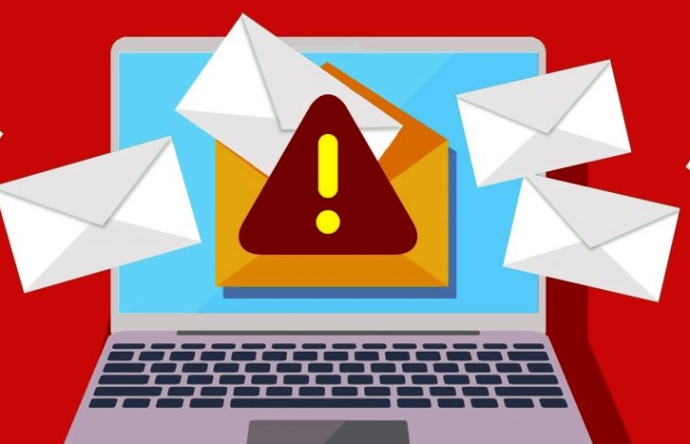

>Domain Drift & Cyber Mayhem
Get Domain Creds
Setup Campaign Builder
Send Campaign Blast
Wreak Havoc at Scale
>> Options: phishing emails, social engineering tactics, or exploiting vulnerabilities in the organization's network.
>> Insider threat could leak sensitive information or maliciously mishandle individual access
>> Choose a campaign platform – in this case, we used Mailchimp for Research purposes
>> Use domain account to verify email address with the service
>> Replace original domain email with spoof sender, (e.g., helpdesk@, support@, etc.)
>> Can send to internal user list or external targets
>> While this requires a compromised domain email to start, the cascading fallout is non-trivial and could be catastrophic based on target and scenario

Slide 6

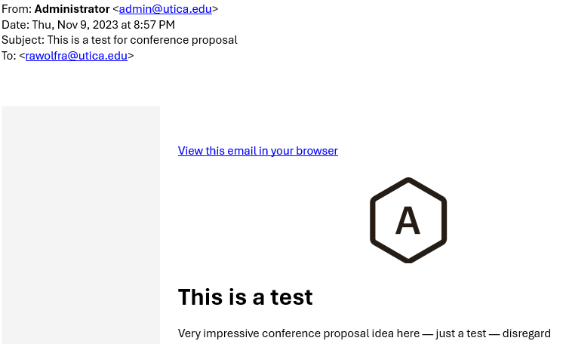
>Let’s Drive this Forward…
Historical HTML Campaigns
>> As of late 2023, marketing platform supported campaign delivery to internal org recipients && external accounts, with only the original account holder address verified with service
>> So, if <pawn>[@]university.edu signed up for service and verified account, then <pawn> can send emails appearing as ANY account (actual or fictitious) with the verified domain.

Slide 7
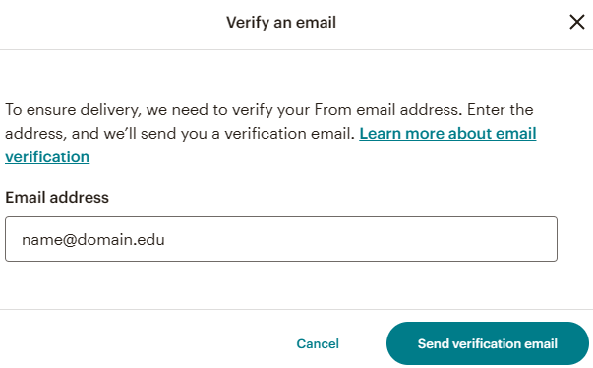
>On Your DMARCs, Ready, Set…
HTML Campaigns 2.0 for 2024
>> Google and Yahoo launched new DMARC requirements that went into effect February 2024 for any org that sends >5K emails – Marketing platform updated their UI to require email verification from individual senders
>> ”…SPF and DKIM provide protection against impersonation through better authentication, while DMARC creates a notification channel back to the domain-name owner to collect information on whether their email is being spoofed.”
Read more: https://www.darkreading.com/cybersecurity-operations/google-yahoo-push-dmarc-forcing-companies-to-catch-up

Slide 8
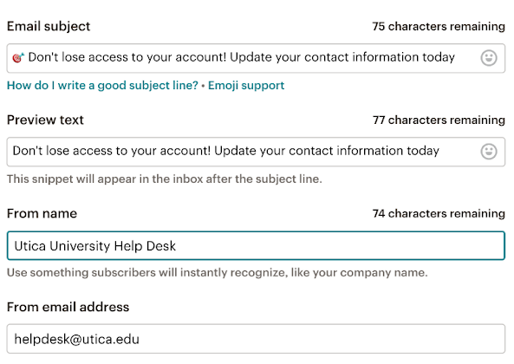
>Let me take you for a ride…
Spoofpocalypse Begins…
>> We registered for service with pawn[@]<university>.edu address, but we’re able to replace the original sender with the desired spoof sender: helpdesk[@]<university>.edu
>> We can customize From name to further drive appearance of legitimacy

Slide 9
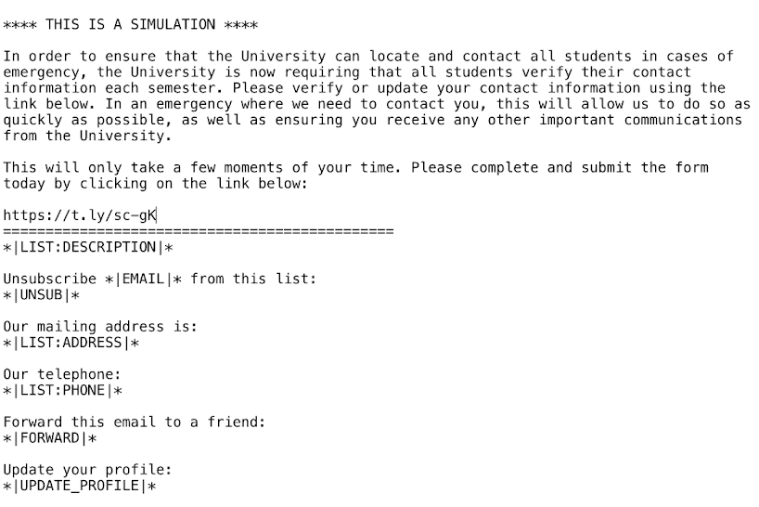
>Going High Octane
Plaintext still packs a punch
>> Plaintext == no styling, just text – no images. Nothing fancy.
>> Lots of orgs use plaintext for legitimate comms – crisis management, service-related info, major time sensitive updates, calls to action, etc.
>> The email body included a URL that routed to a Rick Rolling video…

Slide 10
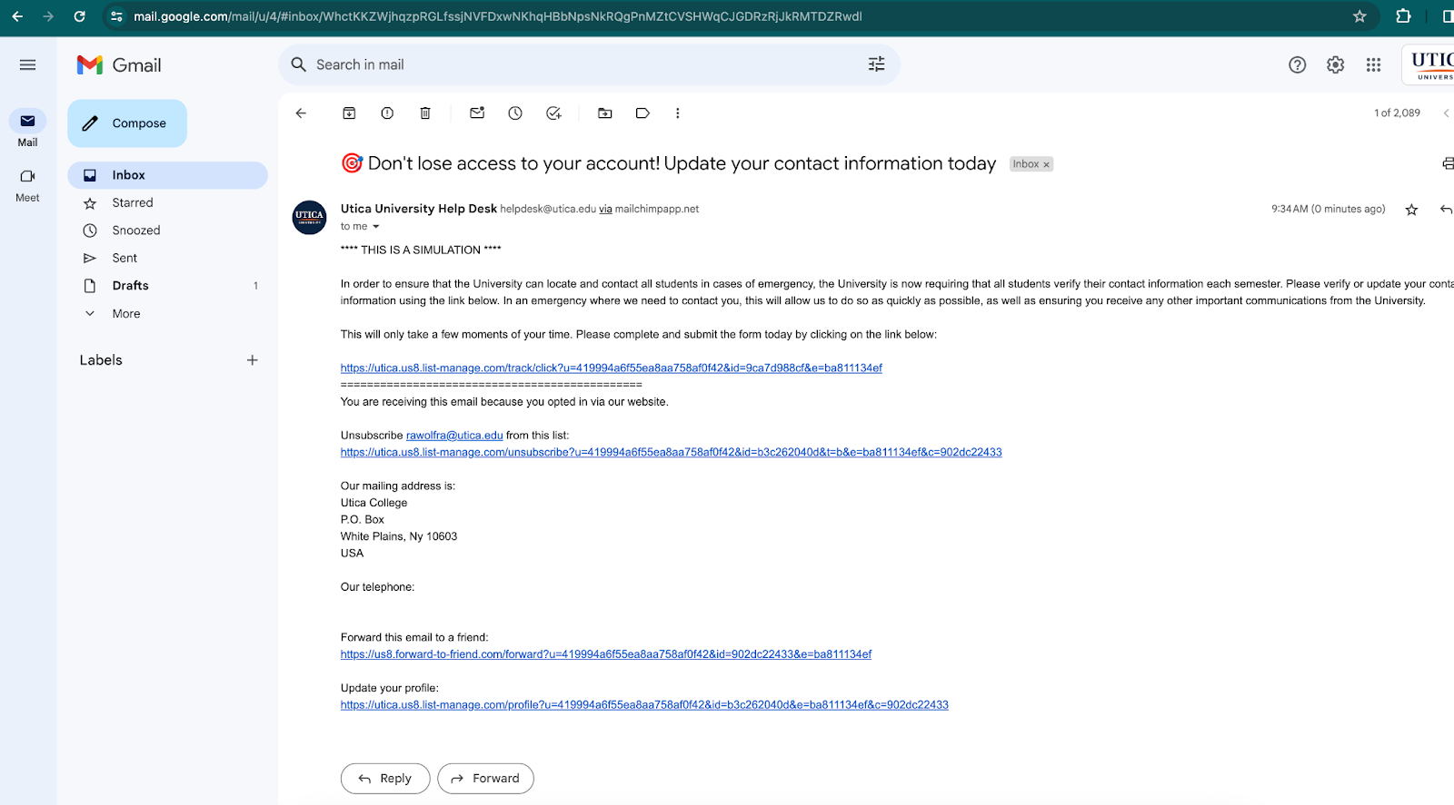
>[Desk]Top Gear POV
Red Flags as Technical Controls
>> Campaign sent to internal org addresses && external recipients – on desktop view, “via mailchimp” is appended to sender
>> Mail still arrived in Inbox without an alert, External banner, etc
>> Do targets got enough sense to not get got?

Slide 11
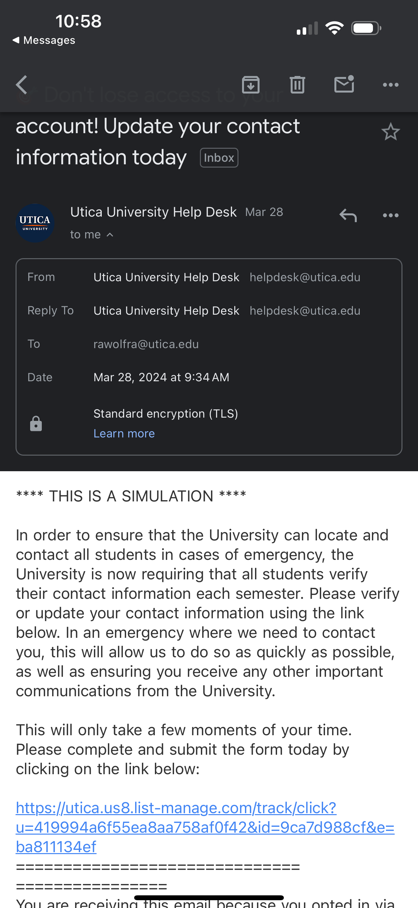
>Winning is winning…
All good rides come to an end(point)!
>> Mobile view comes in flawless, no “via service” appended to sender address
>> Campaign builder converted original URL to a string that includes the domain and appears legitimate

Slide 12


>Engine Check
Submitted a report via Responsible Disclosure program – returned as Out of Scope and Closed
Mar 29, 2024, 1:42 PM EDT
Authentication is our way to ensure safety of your domain and the email that is being sent to arrive in the inbox.
Without authentication, there is not much on our end we can do to ensure these things…this would actually be on your domains end rather than our end here. Either way, authentication will solve this...
Reached out to campaign builder service and shared concerns – received response that the burden is on the org to setup controls
Notified org of the situation and they are working to address
- Name Redacted, Mailchimp
Asking the question: if marketing service can enhance controls for HTML Campaigns – which falls in their control – why is the talk track that orgs can go CTRL F themselves for Plaintext Campaigns?

Slide 13





>Rollout && Follow-up
Vendor Controls
>> Update UI to restrict plaintext email campaigns to send with only verified accounts (at minimum)
Security Program Mitigations
Good Cyber Citizenship
>> SPF, DKIM, and DMARC
>> Set up an external banner or flag for emails delivered by Mailchimp servers
>> Use Advanced Email Filtering Solutions
>> End User Training and Awareness Efforts
>> Google & Yahoo's 2024 DMARC sets new standards in email security to thwart spoofing and phishing.
>> Their lead in the email sector paves the way for broader digital safety, urging all tech sectors to strengthen defenses.
>> A unified effort is key in our interconnected digital world.
Org Controls
>> Strengthen Email Authentication: SPF, DKIM, DMARC help verify the authenticity of incoming emails and prevent spoofing
Notes:
“The implementation of DMARC by these industry leaders not only fortifies their own email ecosystems but also sets a precedent for the broader digital community. It highlights the necessity for collective action in cybersecurity, urging various sectors beyond email services to integrate similar security measures. This approach is vital for protecting the interconnected fabric of the global digital landscape, emphasizing the need for unified cybersecurity efforts across all online platforms and services.”

Slide 14
Thank you

